Slide 1
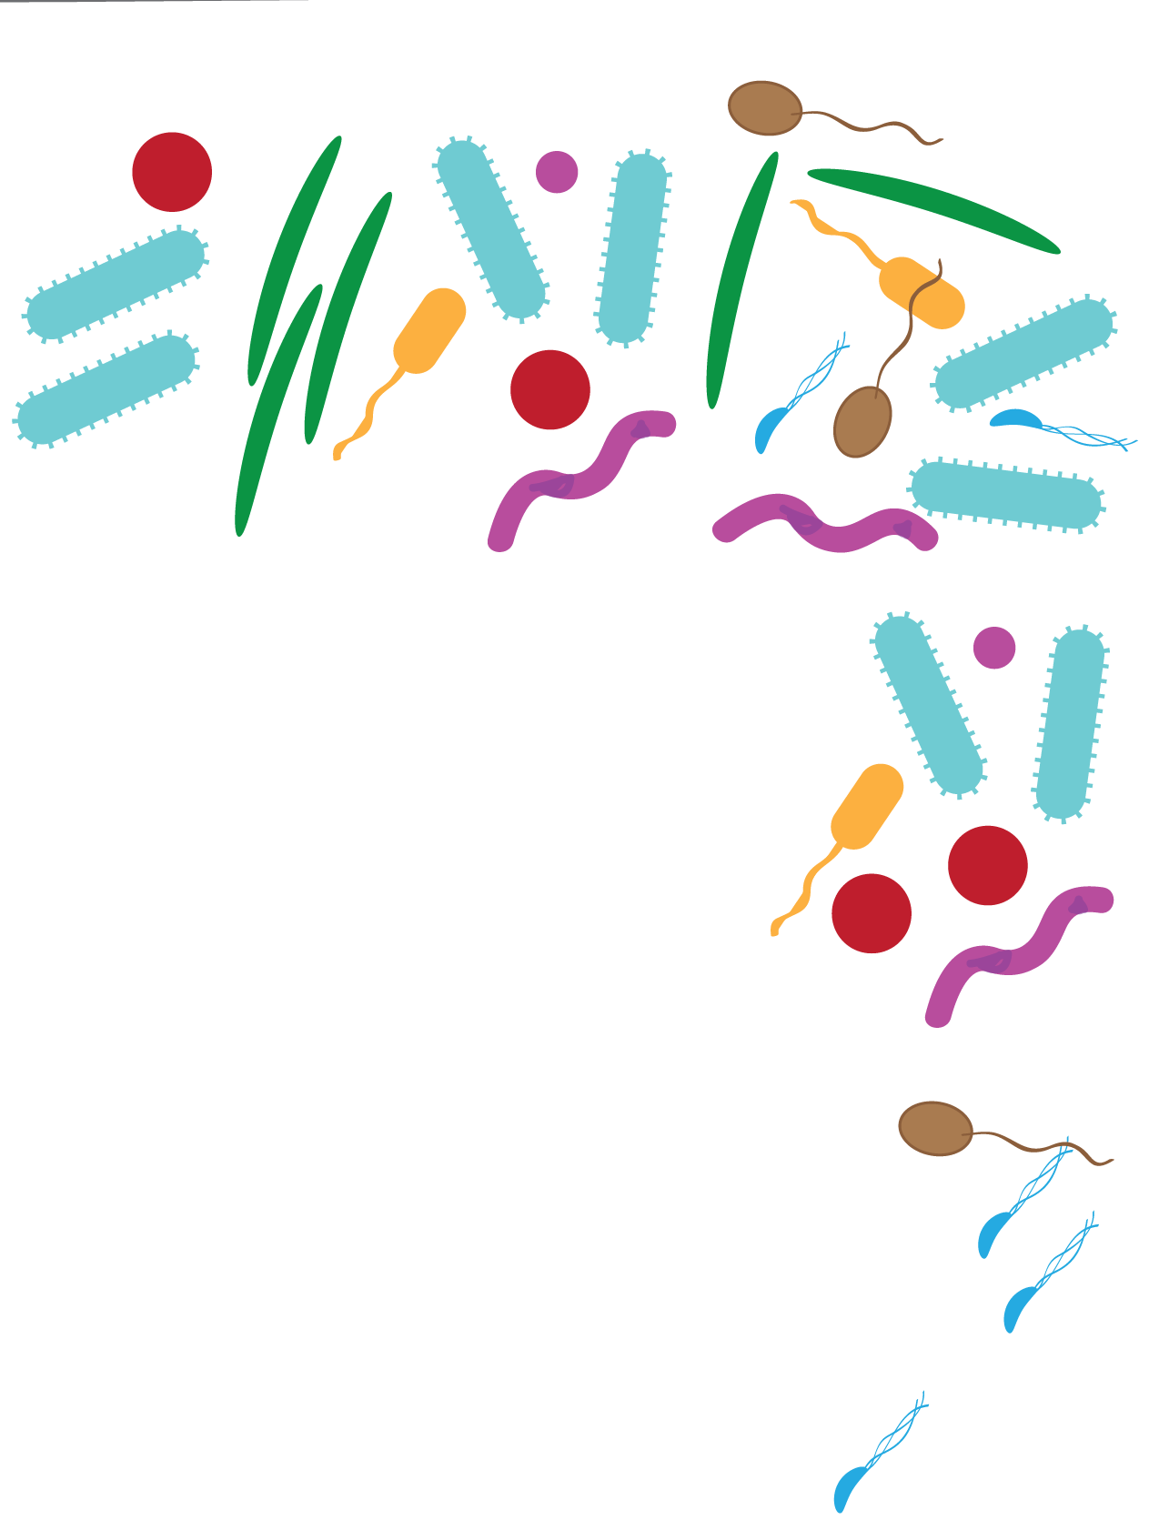
Measuring microbiomes:
β Diversity
Quantitative vs. Qualitative Beta-diversity measures:
Qualitative measures count presence/absence of species
Quantitative measures account for abundance
Phylogenetic measure vs. non-Phylogenetic measures:
non-Phylogenetic measures treat all species/OTUs equally
Phylogenetic measures weight species by their evolutionary relationships

Slide 2
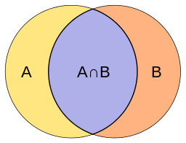
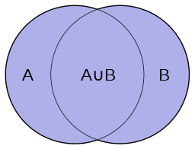
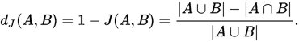
Measuring microbiomes:
β Diversity
How should we measure differences between our communities?
Count how many types are shared vs. unique?

Slide 3
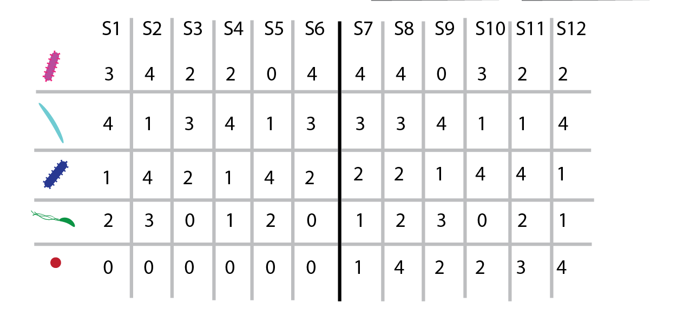
Healthy
Diseased

Slide 4
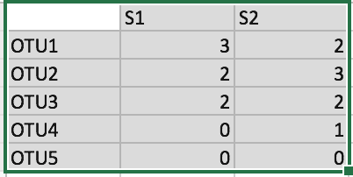
Measuring microbiomes:
β Diversity
Jaccard distance(s1,s2): compares shared vs. unique
OTUs.
S1 and S2 share 3 of 4 OTUs, so they differ
in only 1 of 4 OTUs, or 0.25
Inter-
section
Union

Slide 5
Measuring microbiomes:
β Diversity
Jaccard distance(s1,s2): compares shared vs. unique
OTUs.
More formally:
The intersection of S1 and S2 has
3 OTUs (OTU1,OTU2,OTU3)
The union of S1 and S2 has 4 OTUs (OTU1,OTU2,
OTU3,OTU4)
So we have a Jaccard distance of (4-3)/4 =
¼ = 0.25
Inter-
section
Union

Slide 6
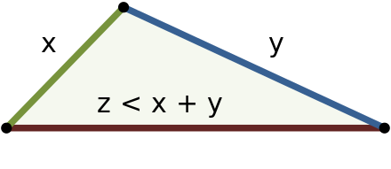


Measuring microbiomes:
Triangle inequality
For a measure of community dissimilarity
to be a distance, it must fulfill the
triangle inequality:
Phrased in terms of some proposed
distance d:

Slide 7
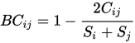
Bray-Curtis Dissimilarity
Bray-Curtis dissimilarity (s1,s2):
Sum of lesser
value of each
pair of species
shared between sites
S_{i} = 7
S_{j} = 8
Total OTUs
Counted at site i
Total OTUs
Counted at site j
Let’s call S1 i and S2 j
C_{ij} = min(3,2) + min(2,3) + min(2,2) = 2 + 2 + 2 = 6
So 2C_{ij} = 12
and the Bray-Curtis divergence Bc_{ij} = 12/15 = 4/5 = 0.80

Slide 8
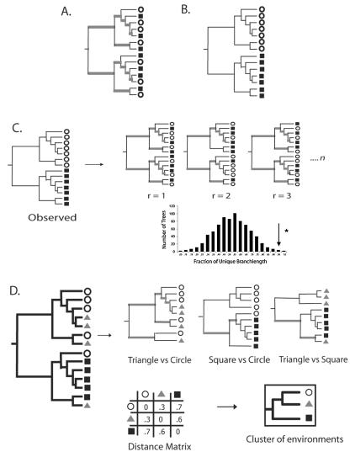
Unweighted UniFrac (Qualitative, Phylogenetic)
Source: Lozupone and Knight,AEM, 2005

Slide 9
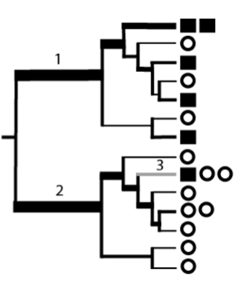
Weighted UniFrac (Quantitative, Phylogenetic)
Bacteria in this group are
mostly represented in the
square environment
Bacteria in this group are
mostly represented in the
circle environment
Source: Lozupone and Knight,AEM, 2005

Slide 10
Measuring microbiomes:
β Diversity distance matrix
Beta-diversity distance matrix
S2 S4 S7
S2
S4
S7
0.0
0.13
0.66
0.13
0.0
0.60
0.66
0.60
0.0
How can we represent complex distance matrices
In a readable form?
Or, how can we represent high-dimensional data
In fewer dimensions while losing as little information
As possible?

Slide 11
Measuring microbiomes:
Principal Coordinates Analysis (PCoA)
Distances
Map
Mexico Highway 1

Slide 12
Measuring microbiomes:
Principal Coordinates Analysis (PCoA)
Beta-diversity distance matrix
Map of sample similarity (PCoA plot)
S2
S2 S4 S7
S2
S4
S7
0.13
0.66
0.0
S4
0.13
0.0
0.60
0.66
0.60
0.0
S7

Slide 13
Measuring microbiomes:
Principal Coordinates Analysis (PCoA)
BUT, no 2d or 3d map fully captures
the community distances….
Just as no flat map perfectly captures
the area, shape, and relative distances
of countries on the earth.

Slide 14
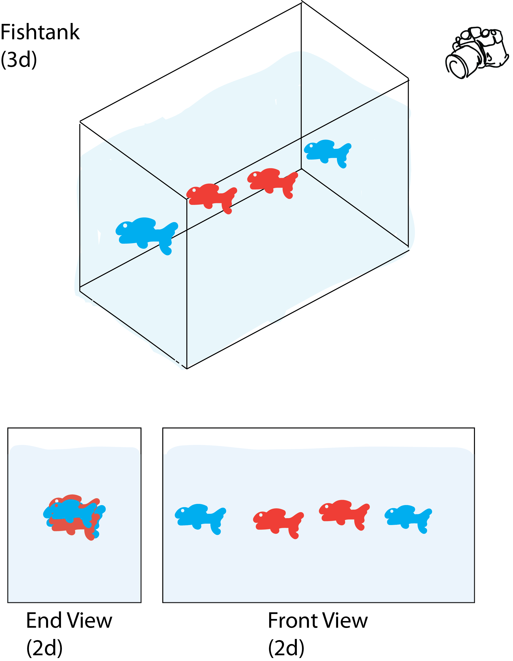
Measuring microbiomes:
Principal Coordinates Analysis (PCoA)
Beta-diversity distance matrix
S2 S4 S7
S2
S4
S7
0.0
0.13
0.0
0.66
0.60
0.0

Slide 15
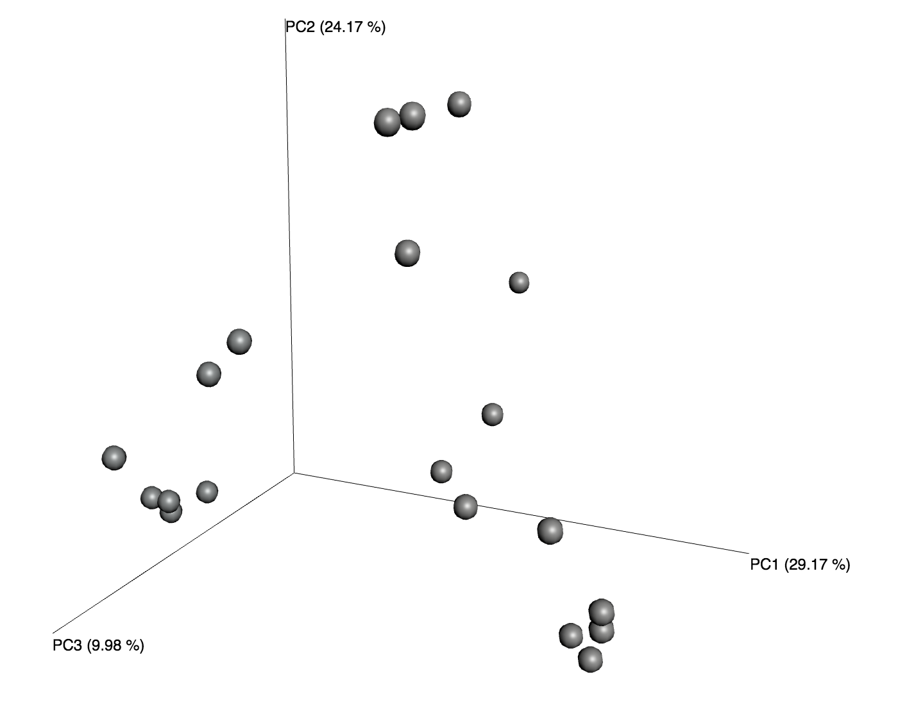
Measuring microbiomes:
Principal Coordinates Analysis (PCoA)

Slide 16
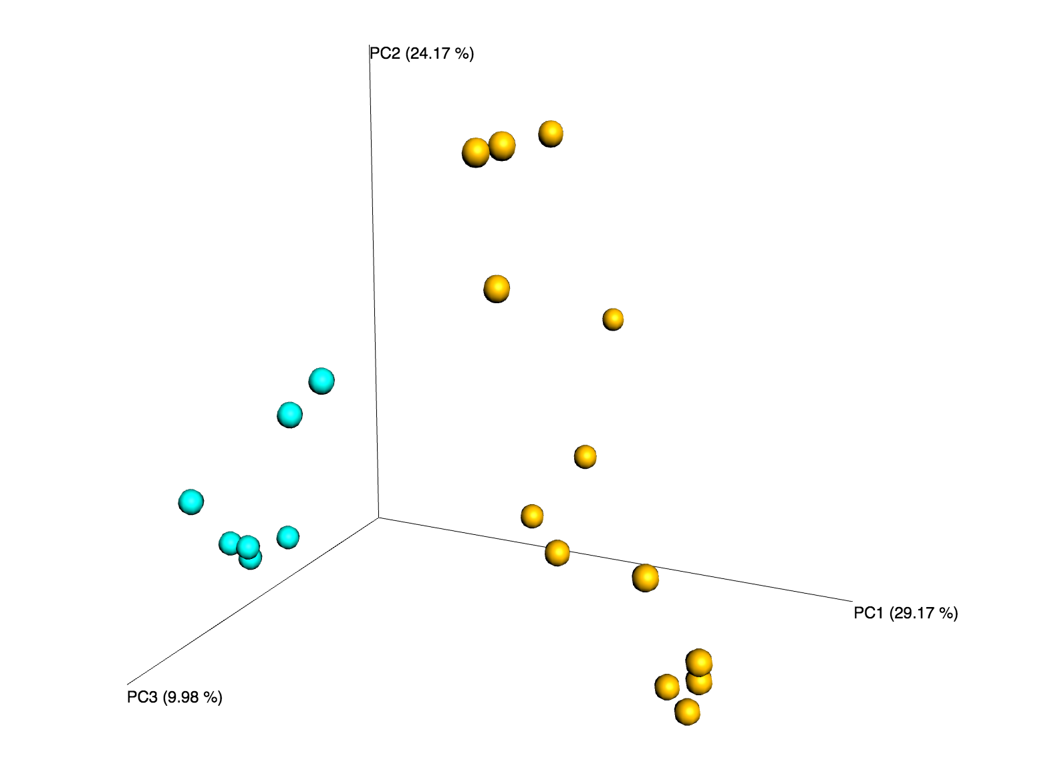
Measuring microbiomes:
Principal Coordinates Analysis (PCoA)

Slide 17
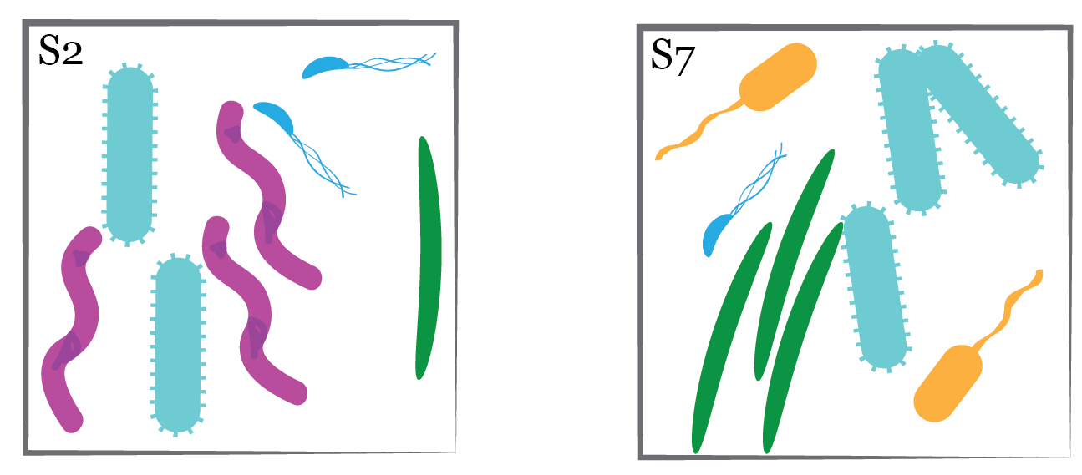
Measuring microbiomes:
Alpha vs. Beta Diversity
Alpha diversity:
Diversity in a particular environment or sample
Example: How many species (or how much
biodiversity) are in S2 and S7, considered
separately
Beta diversity:
Turnover or difference in species across a
landscape
Example: How similar are the species in S2
to those present in S7?
Whittaker, R. H. Evolution and Measurement of Species Diversity. Taxon 21, 213, doi:10.2307/1218190 (1972)

Slide 18
Alpha diversity: richness and evenness
Richness: diversity of species or OTUs within a given sample

Slide 19
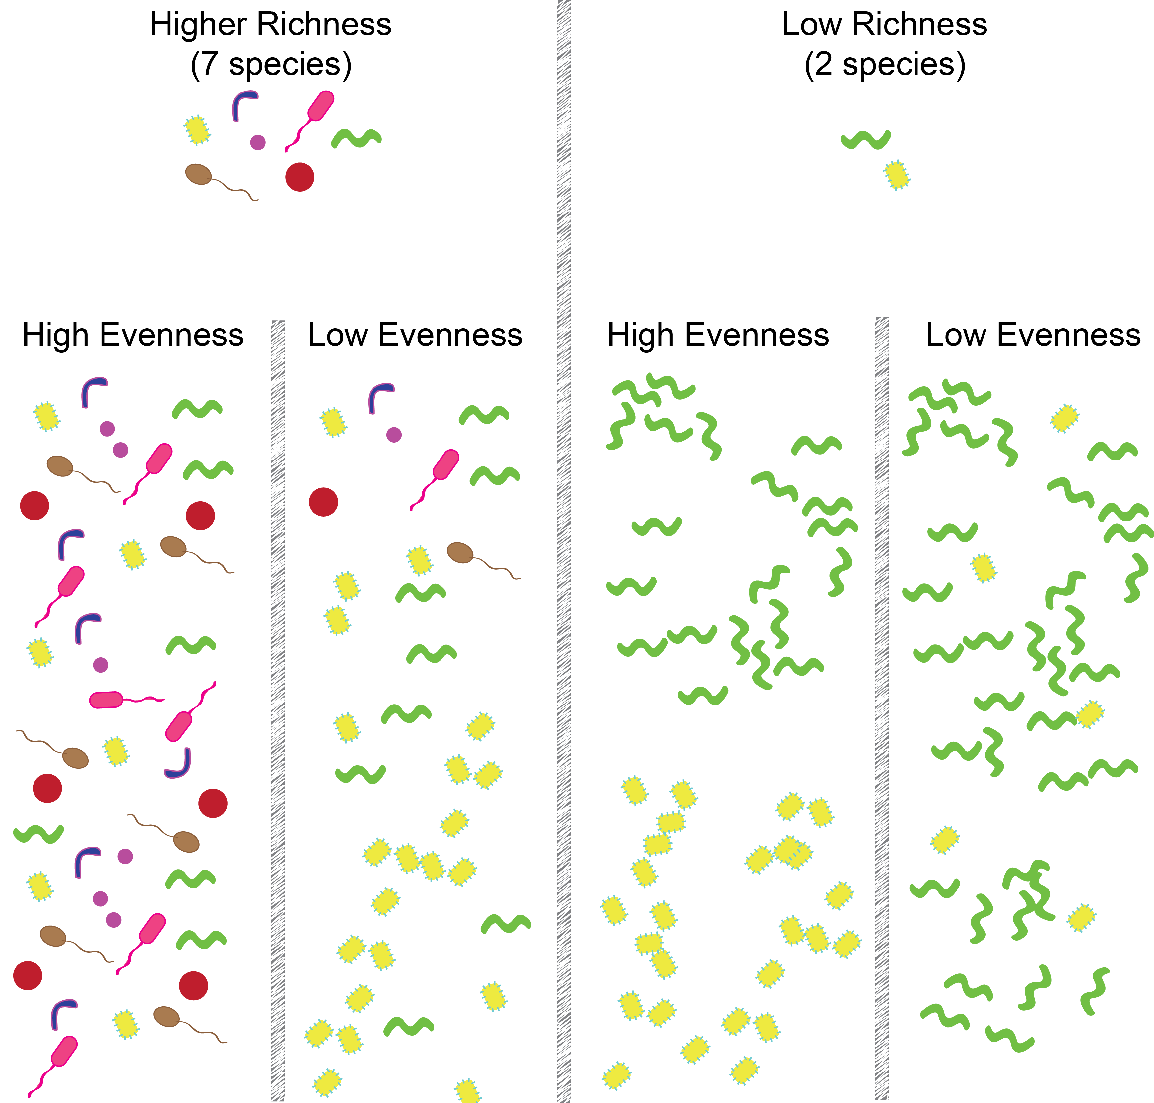
Alpha diversity: richness and evenness
Richness: diversity of species or OTUs within a given sample

Slide 20
Observed species – simply the number of species observed Chao1- number of species observed, attempting to correct for sampling effort
Alpha diversity: common measures of richness

Slide 21
Alpha diversity: common measures of richness
5 species

Slide 22
Alpha diversity: common measures of richness
Vs.
5 species
Also 5 species!

Slide 23
Faith’s Phylogenetic Diversity (PD) – portion of reference evolutionary tree represented
Alpha diversity: common measures of richness
Vs.
5 species
Also 5 species!

Slide 24
Faith’s Phylogenetic Diversity (PD) – portion of reference evolutionary tree represented
Alpha diversity: common measures of richness
Vs.
5 species
Also 5 species!

Slide 25
Observed species – simply the number of species observed Chao1- number of species observed, attempting to correct for sampling effort Faith’s Phylogenetic Diversity (PD) – portion of reference evolutionary tree represented (weights unrelated species more heavily than close relatives)
Alpha diversity: common measures of richness
It’s good to know the theory, but
in practice these are often (but not always)
highly correlated

Slide 26
Alpha diversity: richness and evenness
Evenness: equal or unequal abundance of microbes in a sample
(“the top 1% of most abundant OTUs account for 70% of sequence reads”)

Slide 27
Alpha diversity: richness and evenness
Evenness: equal or unequal abundance of microbes

Slide 28
Richness: OTU diversity within a sample
Evenness: equal or unequal OTU abundance

Slide 29
Richness: OTU diversity within a sample
Evenness: equal or unequal OTU abundance

Slide 30
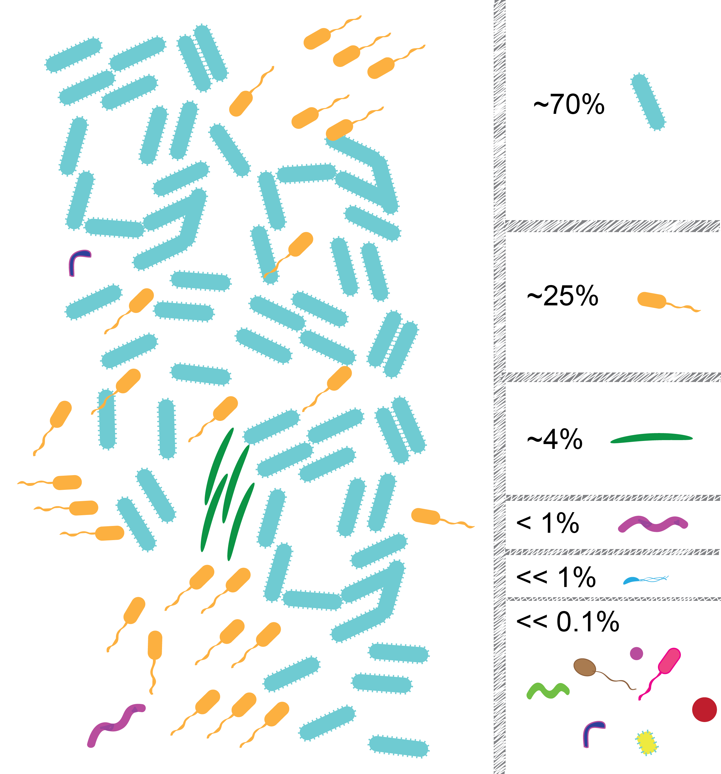

Slide 31
Microbial communities typically have relatively few abundant OTUs, and many rare OTUs

Slide 32
Microbial communities typically have relatively few abundant OTUs, and many rare OTUs (i.e. they are not perfectly even, and counts are far from uniformly distributed across species)

Slide 33
Microbial communities typically have relatively few abundant OTUs, and many rare OTUs (i.e. they are not perfectly even, and counts are far from uniformly distributed across species)

Slide 34
What implications does this
have for microbial community
analysis?
Implication 1:
Until the community is fully
enumerated, deeper sampling
(i.e. more DNA sequences) will
uncover more unique OTUs

Slide 35
Let’s do some (back of the envelope) simulation:

Slide 36
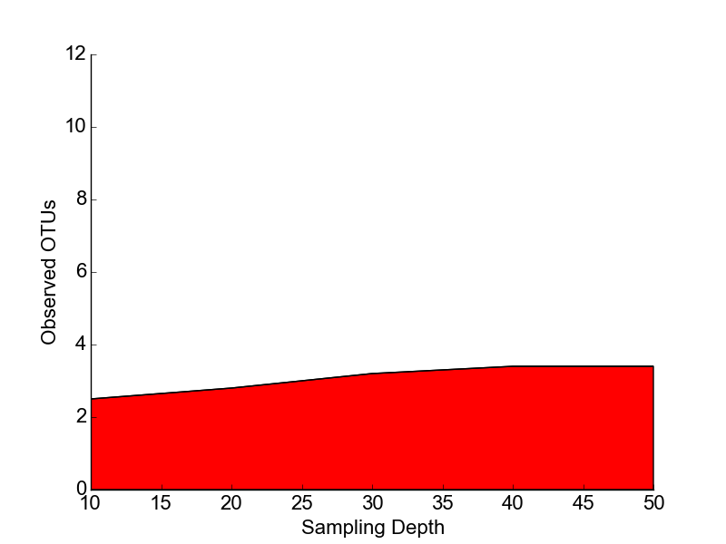
Let’s do some (back of the envelope) simulation:

Slide 37
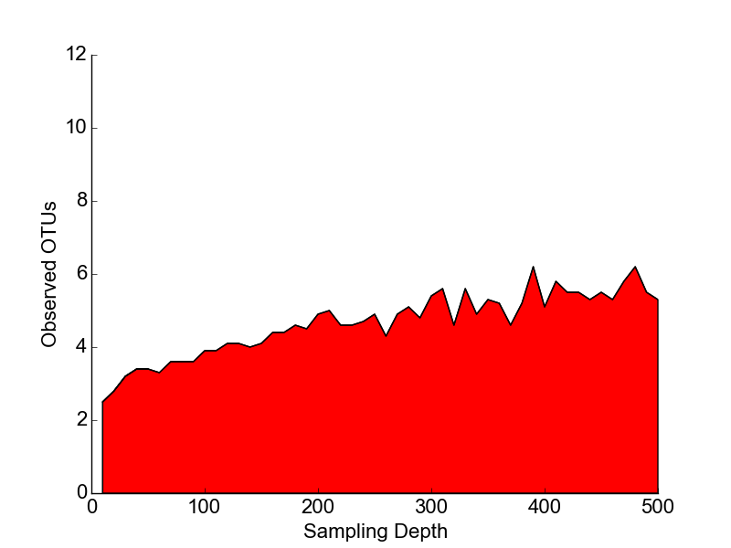
Let’s do some (back of the envelope) simulation:

Slide 38
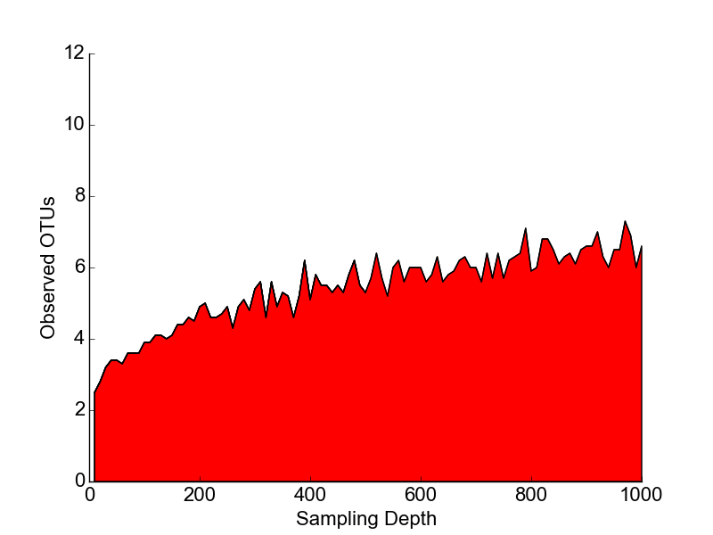
Let’s do some (back of the envelope) simulation:

Slide 39
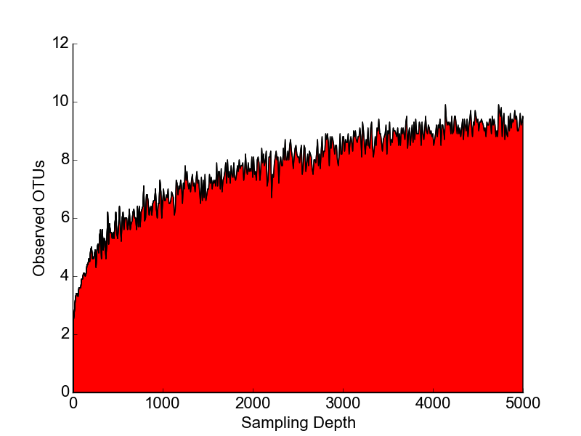
Let’s do some (back of the envelope) simulation:

Slide 40
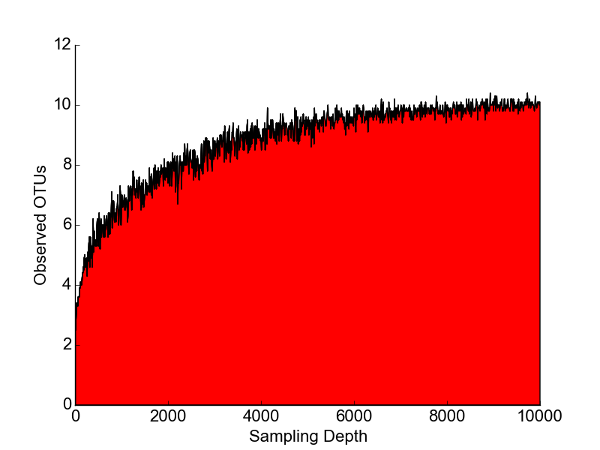
Let’s do some (back of the envelope) simulation:

Slide 41
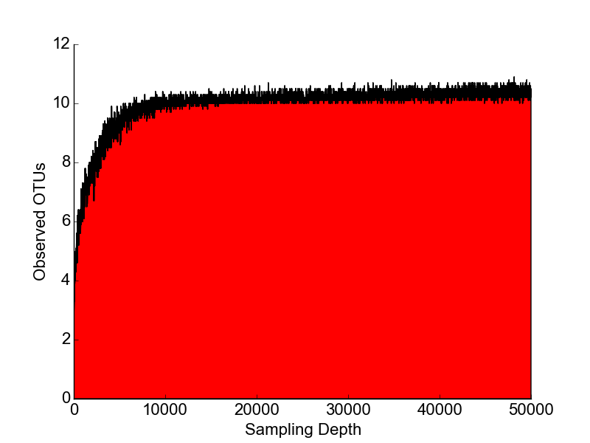
Let’s do some (back of the envelope) simulation:

Slide 42
Implication 1:
Until the community is fully
enumerated, deeper sampling
(i.e. more DNA sequences) will
uncover more unique OTUs

Slide 43
Implication 2:
Depending on whether rare or common
taxa are preferentially shared between
two samples, Beta-diversity will increase or
decrease with sampling depth

